Slide 1
Group 17: Project #16 - Health AI 5
By: Chirayu Tripathi, Sakshi Pandey, Shikhar Panwar, Pranav Gautam, Vishrut Mehta

Slide 2
Introduction
In an era where the intersection of healthcare and technology is more critical than ever, the role of data in shaping healthcare outcomes is undeniably crucial. Our project stands at this crossroads, delving into how advanced data augmentation and machine learning techniques can significantly enhance decision-making processes in healthcare.
Our work is a deep dive into the realm of data-driven healthcare, where we confront and tackle the prevalent challenges of limited data availability, data quality concerns, and the need for accurate patient classification. Central to our exploration is a rich and informative dataset, named "dataset_project5.csv."
This dataset, comprising comprehensive blood count profiles (CBC) of patients, is more than just a collection of numbers; it's the key to unlocking personalized patient care strategies. By analyzing this dataset, we aim to decode complex patterns and categorize patients into crucial care pathways - inpatient or outpatient - decisions that are fundamental to patient treatment and healthcare management.
In the following slides, we embark on a journey through the multifaceted landscape of our project. We will unfold the layers of data augmentation, delve into the critical steps of data preprocessing, and showcase the power of sophisticated classification models. This journey is not just about processing data but about transforming it into a beacon that guides healthcare decisions, enhancing the efficacy and personalization of patient care.

Slide 3
Work Distribution
Chirayu Tripathi: Model Training and Data Augmentation - Method 2/3
Sakshi Pandey: Research, Data Analysis/Preprocessing, Presentation, Video
Shikhar Panwar: Model Interpretation and Feature selection
Pranav Gautam: Data Augmentation - Method 1
Vishrut Mehta: AI Fairness and Model Performance

Slide 4
Data Analysis and Preprocessing
In our project, we meticulously analyzed and cleaned the dataset to ensure high data quality. This process involved:
1. Descriptive Statistics Analysis: We analyzed both the original and augmented datasets to understand central tendencies, data spread, and the range of values for each numerical attribute.
2. Missing Value Checks: Checks were performed on the dataset to ensure no missing values were present.
3. Data Normalization: To enhance data comparability and reduce outlier impacts, we applied Min-Max scaling to key numerical features, alongside duplicate removal.
4. Data Visualization: We employed histograms with kernel density estimation (KDE) to visualize the distribution of numerical data columns, gaining deeper insights into frequency patterns and data characteristics.
This approach ensured our dataset was optimally prepared for robust data analysis and machine learning application in healthcare.

Slide 5
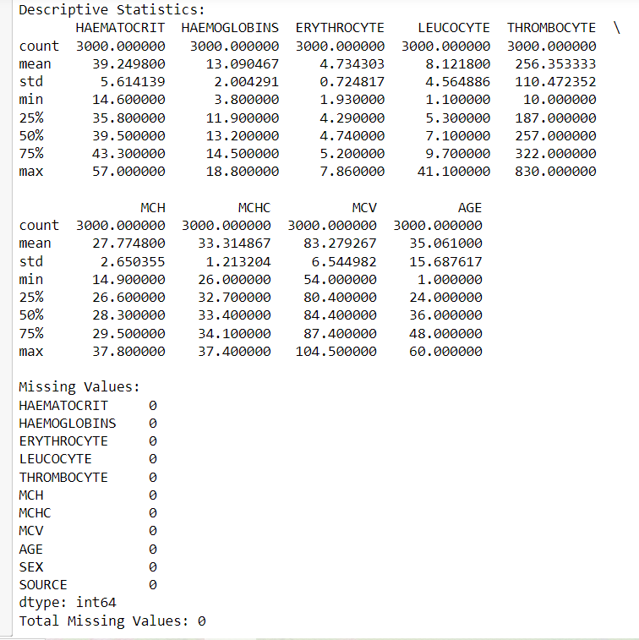
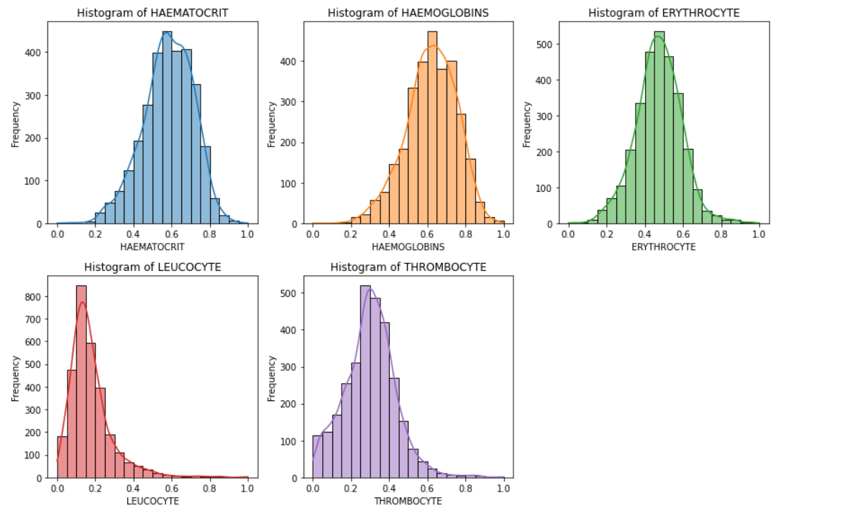
Data Analysis and Preprocessing

Slide 6
Classification Model and Model Training
In our project, the effectiveness of our classification model was crucially dependent on the strategic choice and application of machine learning algorithms.
XGBoost (Extreme Gradient Boosting):
- We opted for XGBoost, a renowned ensemble learning method celebrated for its efficiency and strong predictive capabilities, especially in classification tasks.
- XGBoost utilizes advanced boosting techniques to create a robust ensemble of decision trees, making it highly effective for our purposes.
- Its proficiency in handling imbalanced datasets, a frequent issue in healthcare data, made it an ideal choice for our analysis.
Feature Selection: To boost our model's efficiency and interpretability, we implemented feature selection methods such as SelectKBest, utilizing ANOVA F-statistic and mutual information. This approach aided in pinpointing the most impactful attributes for our model.
Performance Metrics:
- The evaluation of our model was thorough, leveraging various metrics like AUROC, AUPRC, sensitivity, specificity, precision, and accuracy.
- These metrics were instrumental in gauging the model's precision in predictions and its applicability in supporting healthcare decision-making
Through this meticulous approach, we ensured our model was not only accurate but also relevant and practical for use in healthcare contexts.
Notes:
We choose XGBoost because it is an ensemble learning method known for its predictive capabilities, and it is particularly suitable for handling imbalanced datasets, which is a commonly occuring challenge in the healthcare applications, and also, we can make use of XGBoost’s boosting techniques like extreme gradient boosting to build a strong ensemble of decision trees.
Our model employees feature selection techniques like SelectKBest with ANOVA F static for selecting the most relevant attributes, and we rigorously evaluated our model's performance using a range of metrics such as AUPRC, specificity, accuracy, etc.

Slide 7
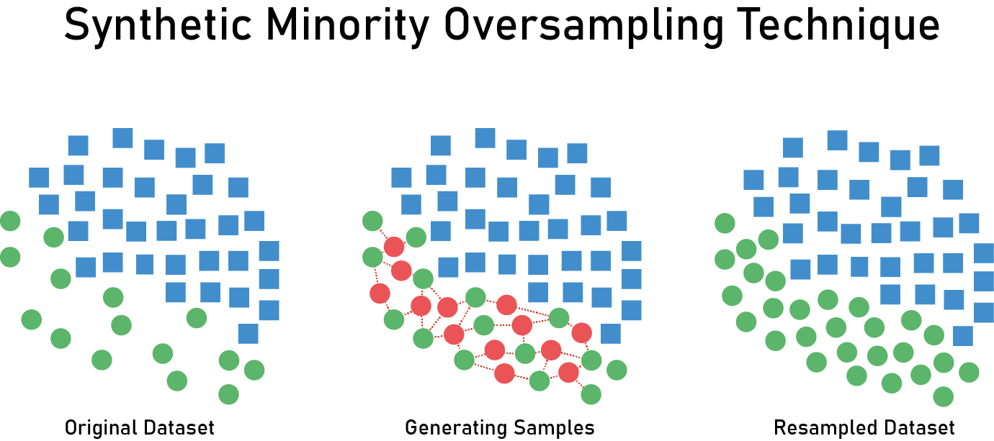
Data Augmentation: Method 1
source
Two data augmentation techniques, including SMOTE, are employed to expand the dataset, enriching the training and testing data to bolster the classification model's performance.
SMOTE(Synthetic Minority Over-sampling Technique) -
SMOTE is an over-sampling method for addressing class imbalance in tabular data. It creates synthetic data points by interpolating between each minority class sample and its "k" nearest neighbors (usually 5). This process rebalances the dataset and enhances model performance. SMOTE is a pivotal technique for mitigating class imbalance challenges in machine learning.
SMOTENC(Synthetic Minority Over-sampling Technique for Nominal and Continuous features) -
SMOTENC, an extension of SMOTE, is tailored for datasets containing both nominal (categorical) and continuous (numerical) features. While SMOTE generates synthetic samples by interpolating between a minority class sample and its neighbors, SMOTENC takes feature types into account.
It adapts its strategy for nominal attributes, selecting neighbors with similar categorical values for synthetic instance creation. This specialized approach ensures more robust data augmentation for datasets with mixed attribute types, making SMOTENC a versatile and ideal choice for enhancing our dataset’s class balance and model performance.
Following the use of SMOTENC our data augmentation method yielded 748 additional samples for the class 'in'.

Slide 8
Data Augmentation: Method 2
Introduction to VAE: Leveraging the power of Variational Auto Encoders, our project introduces advanced data augmentation methods to address key challenges in healthcare analytics.
Sampling Without Noise: This technique employs VAE to accurately replicate the underlying distributions of our classes, such as 'In' and 'Out', in the dataset. It enriches the data by sampling new points that maintain the original characteristics, ensuring data integrity and consistency.
Sampling With Noise: Building upon the previous method, this approach introduces controlled random noise during the sampling process. By doing so, it adds realistic variability to the data, mirroring real-world scenarios. This not only enhances the robustness of our predictive models but also ensures they are better equipped to handle unexpected data variations.
Impact on Model Performance: These VAE-based techniques have been instrumental in improving the diversity and realism of our dataset, leading to more reliable and generalizable models in healthcare decision-making.

Slide 9
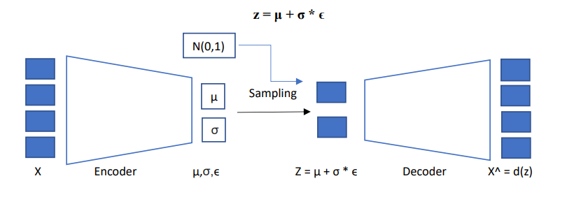
Data Augmentation: Method 2

Slide 10
Model Performance
Test Scores for No Augmentation:
auroc: 0.72
auprc: 0.86
sens: 0.92
spec: 0.51
ppv: 0.75
npv: 0.81
acc: 0.76
Test Scores for SMOTE-NC:
auroc: 0.75
auprc: 0.83
sens: 0.78
spec: 0.73
ppv: 0.77
npv: 0.74
acc: 0.75
Notes:
So this is our model’s performance, we can see that after Data Augmentation we observed notable improvements in key metrics, including an increased AUROC of 0.78 and improved specificity at 0.73.

Slide 11
Model Performance
Test Scores for Sampling without noise:
auroc: 0.85
auprc: 0.91
sens: 0.93
spec: 0.77
ppv: 0.85
npv: 0.88
acc: 0.86
Test Scores for Sampling with noise:
auroc: 0.84
auprc: 0.90
sens: 0.91
spec: 0.76
ppv: 0.84
npv: 0.87
acc: 0.85
Notes:
So this is our model’s performance, we can see that after Data Augmentation we observed notable improvements in key metrics, including an increased AUROC of 0.78 and improved specificity at 0.73.

Slide 12
Model Interpretation
We utilized the SHAP (SHapley Additive exPlanations) library to interpret and visualize the model's predictions, from the XGBoost model trained on the original and augmented datasets.
We created summary plot to provide an overview of feature importance by displaying the distribution of SHAP values for each feature.
A bar plot was also created ranking and highlighting the most influential features in the model's decision-making process.
Lastly, We produced a waterfall plot illustrating the incremental contributions of each feature to the prediction's final outcome. This aids in understanding the reasoning behind individual predictions and model behavior.
Notes:
We used SHAP library to visualize our model's prediction from the XGBoost model trained on the original and augmented datasets.

Slide 13
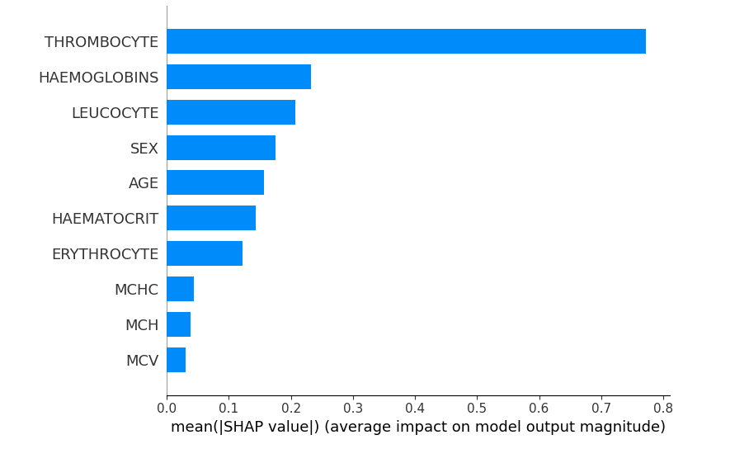
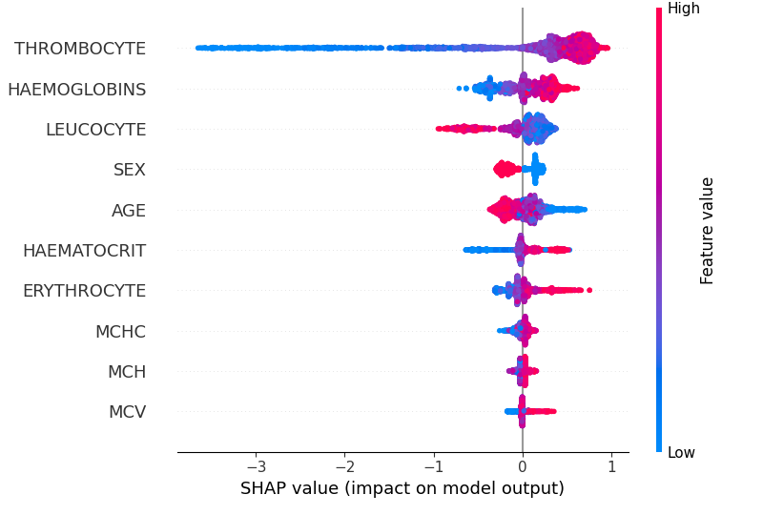
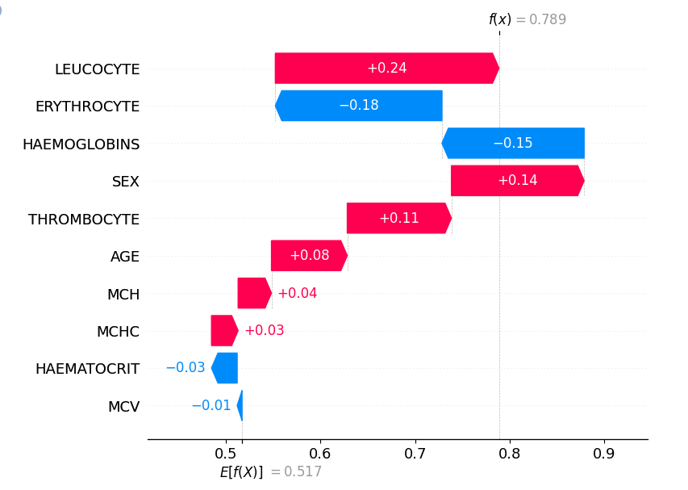
Model Interpretation
Notes:
We displayed the distribution of SHAP values for each feature in a summary plot, and also created a bar plot highlighting the decisive features in our model. Also, we made a waterfall plot showing the incremental contribution of each feature to the prediction's outcome, to help provide reasoning behind individual predictions.

Slide 14
AI Fairness
Evaluating and addressing AI fairness to understand if a model is biased towards male or female gender is an important step in machine learning and AI development.
For this appropriate fairness metrics need to be selected like disparate impact, equal opportunity, etc. to measure bias in the model.
Tools like AIF360, Fairlearn, FairML can help with evaluating the model.
Models are examined to predict and identify instances where bias exists. If bias is detected, then bias mitigation techniques are used to reduce bias.
We conducted fairness on our dataset and found disparate impact to be 0.96 for first task i.e. no augmentation and one for the second task i.e. first augmentation. The disparate impact for the second augmentation task was around 0.86, while disparate impact for the third augmentation task was around 0.56.
Notes:
Evaluating fairness for a machine learning model is crucial to know its biases. We can use fairness matrices like disparate impact, equal opportunity, etc. to perform the same. We found disparate impact to be 0.96 on our dataset.

Slide 15
Conclusion
In conclusion, our project successfully demonstrated the transformative impact of advanced data augmentation techniques, like SMOTE-NC and Variational Auto Encoder (VAE) based sampling, on healthcare data analytics. By intelligently addressing class imbalance and enhancing data diversity, we significantly improved our model's accuracy and robustness. These methods proved pivotal in refining our predictive models, paving the way for more reliable and effective healthcare decision-making processes. This project not only underscores the importance of sophisticated data handling in healthcare but also highlights the potential for such approaches to revolutionize patient care and treatment outcomes.

